Slide 1
European Fundamental Values in Digital Era
Workshop for students (no 1, date 8 November 2022)
Agenda:
Data protection in the EU and in Ukraine
Blockchain, artificial intelligence and the law
Legal framework for digital content and digital services
Topic:
Digital platforms: their impact, duties and responsibilities

Slide 2
European Fundamental Values in Digital Era
This project purports to provide a European Fundamental Values based framework for the issues shaped and brought about by digitalization in Ukraine. For this purpose, the Interdisciplinary Research Hub on European Fundamental Values and Digitalization will be established at Yaroslav Mudryi National Law University.
The project consists of three parts: research, educational (sharing) and policy-making.
ERASMUS-JMO-2022-HEI-TCH-RSCH
ERASMUS-JMO-2022-COE — Jean Monnet Actions in the field of Higher Education: Centres of Excellence
Project: 101085385 — EFVDE
Funded by the European Union. Views and opinions expressed are however those of the author(s) only and do not necessarily reflect those of the European Union or European Education and Culture Executive Agency. Neither the European Union nor the granting authority can be held responsible for them.

Slide 3
Normative role of digital platforms
Significant impact on legal regulation and practice
‘Design’ of processes (architecture of platforms, default settings)
Interpretation of human rights (freedom of expression and hate speech, privacy)
‘Justice’ (complaints on platforms, dispute resolution)
Agreements (terms and conditions, check box)

Slide 4
Use of data in the activities of digital platforms
Data protection vs data driven economy
GDPR
Data as a resource
Data as power for artificial intelligence
Primary, secondary and behavioral data
Profiling and targeting
Offers for the sale of user data

Slide 5
Social media platforms
Democratic processes
Influence on elections
Growing polarization
‘Neutral’ status
Public or private sector?

Slide 6
Platforms and promotion of polarization
‘Competitive’ struggle
Replacement of news portals
Funnel of hatred
Responsibility for content
Eg: The case of Facebook in Myanmar

Slide 7
Algorithms in the activity of digital platforms
Maximum involvement in spending time on a digital platform
‘Hate’ cliques
Forming a feed for product promotion or data collection
Kind of like increasing the choices you have
Shaping reality
Commercial interests

Slide 8
Curation algorithm in social media
Invisible character
Manipulative design
Tracking reactions
‘Real time’ mode
Keywords
Digital traces

Slide 9
The future of artificial intelligence and the activities of digital platforms
Systems of high, medium and low risk
Eg: The proposal for a regulation of the European Parliament and of the Council Laying Down Harmonised Rules on Artificial Intelligence (Artificial Intelligence Act, AIA) and Amending Certain Union Legislative Acts [COM/2021/206 final]
Contextual smart algorithms
Self-learning algorithms + metauniverse
AI for justice and equality
AI for the rule of law

Slide 10
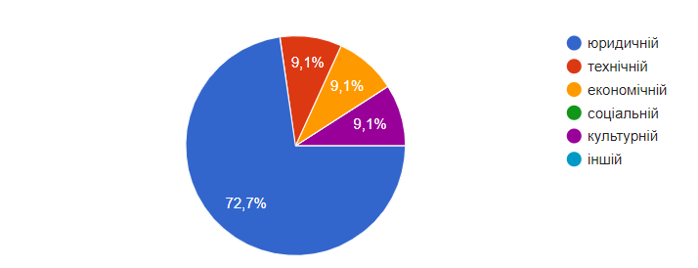
Survey on European fundamental values
Workshop participants - 23
Agreed to participate in an anonymous survey -11
Question 1: What field of activity do you plan to engage in?
Answers: legal sphere 72.7 percent, technical sphere 9.1 percent, economic sphere 9.1 percent, cultural sphere 9.1 percent, social sphere 0 percent.

Slide 11
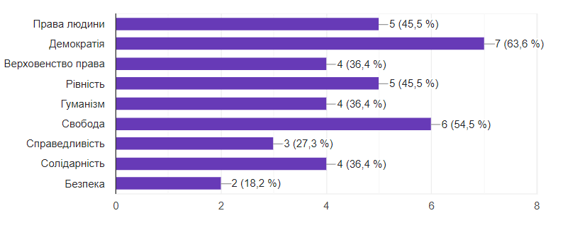
Survey on European fundamental values
Question 3: Which European values have been positively influenced by digitization??
Answers:
Human rights - 45.5 percent, Democracy - 63.6 percent, Rule of law - 36.4 percent, Equality - 45.5 percent, Humanism - 36.4 percent , Freedom - 54.5 percent, Justice - 27.3 percent, Solidarity - 36.4 percent, Secutity - 18.2 percent

Slide 12
Survey on European fundamental values
Question 4: What should be the responsibility of online platforms in the digital age?
Answers:
(1) The responsibility must be civil liability
(2) They should be held accountable for content that violates human rights requirements
(3) The responsibility should be the same as the publishers have
(4) The responsibility must be effective
(5) Responsibility should be as well as careful verification of information, because as of today, online platforms are the primary sources of information, which should be responsible for their activities
(6) Responsibility must be according to the international law
(7) It would seem that no data should be collected, but it is objectively more convenient when YouTube offers, for example, other videos based on your subscriptions. But when you clear the browser history, you search for what you need for a long time. The solution seems to be a clear form, where all the points on which data are collected are indicated and the person will put a tick where he agrees. In terms of responsibility, there should be high fines.
(8) The responsibility should be liberal
(9) Nowadays, online platforms are a significant part of our daily life, and that is why the responsibility of online platforms should be full, but of course within the limits of the law

Slide 13
Thetraining materials were prepared by the project team of The Jean Monnet Center of Excellence European Fundamental Values in Digital Era, 101085385 – EFVDE – ERASMUS-JMO-2022-HEI-TCH-RSCH
You can contact us cledt@nlu.edu.ua

